Slide 1


SQL PROJECT
Presented by
BHAVINI SADARA

Slide 2

PROJECT TITLE
ZOMATO EXPLORATION DATA
This dataset contains information about various restaurants listed on the platform, including their location, cuisine type, ratings, user reviews, and other essential attributes.
The data is designed to help researchers, data enthusiasts, and analysts gain insights into the restaurant industry, customer preferences, and regional culinary trends.

Slide 3
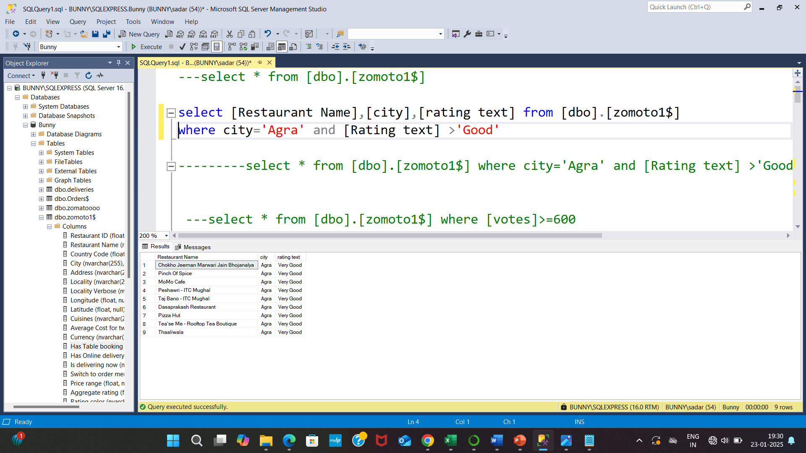
1.Display all restaurant name in the city name Agra. Where the rating test like more than good ?
select [Restaurant Name],[city],[rating text] from [dbo].[zomoto1$] where city='Agra' and [Rating text] >'Good’
OUTPUT :

Slide 4
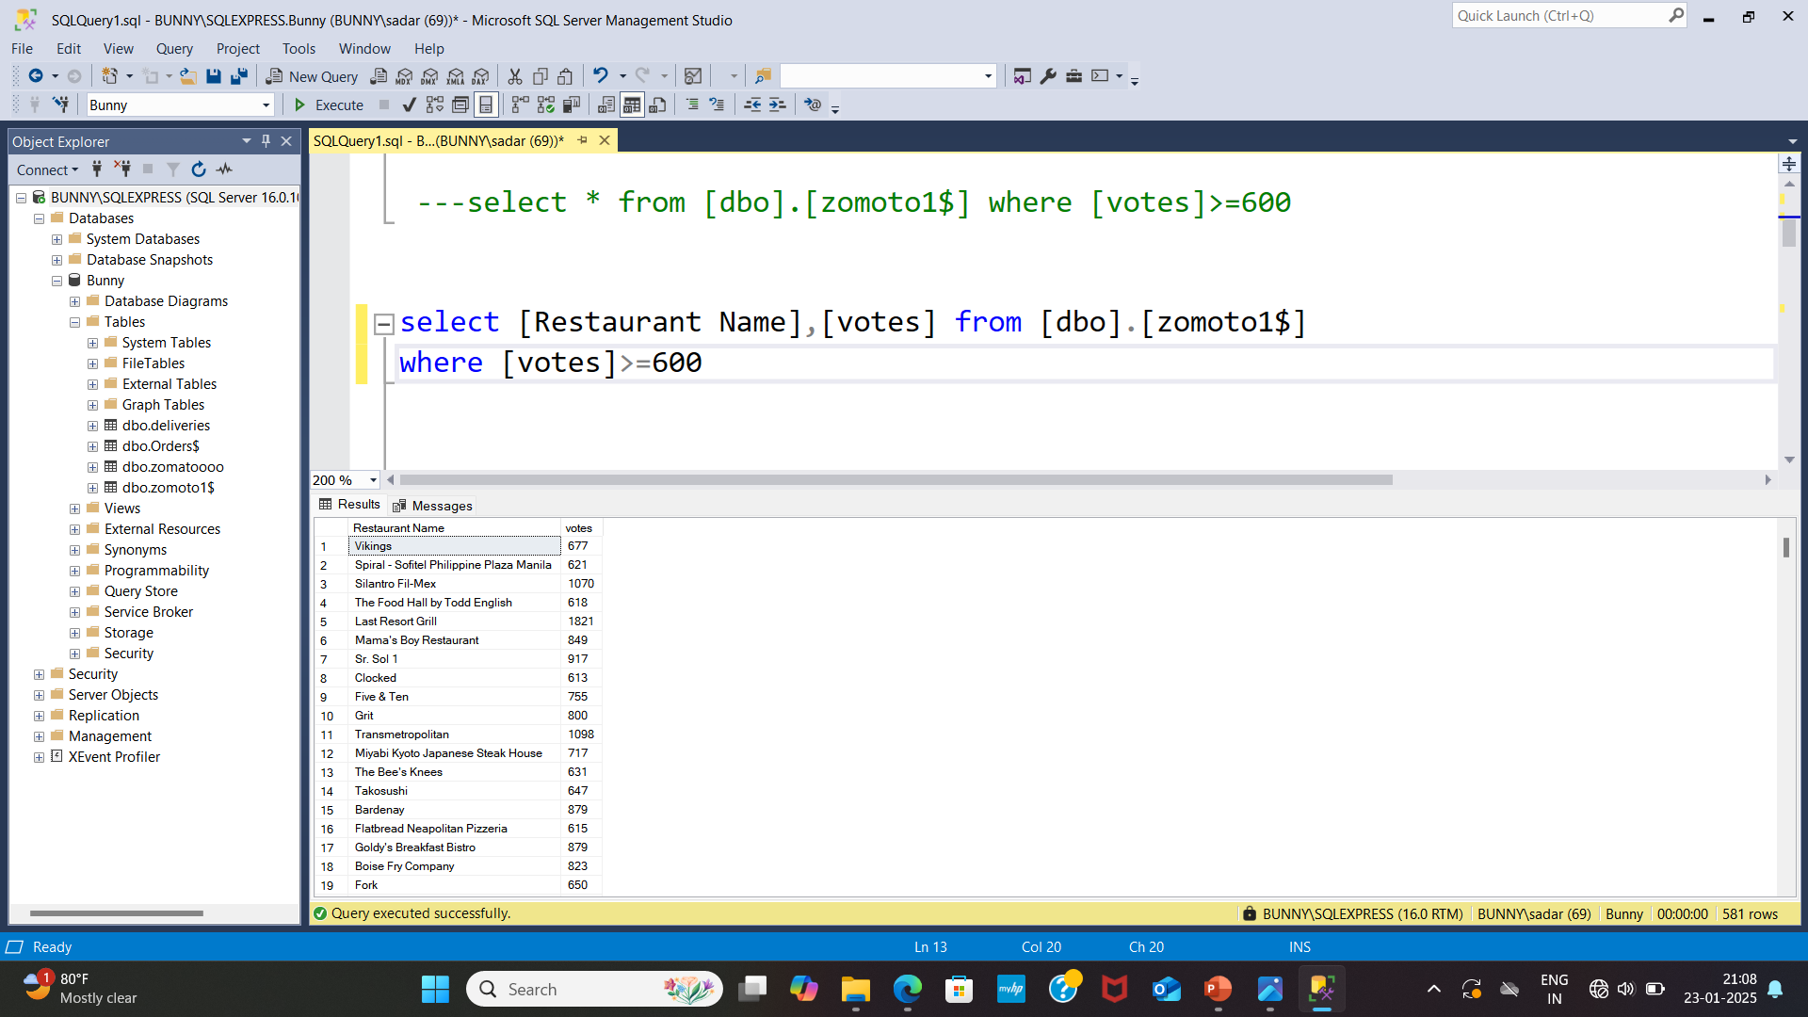
2.Find out the restaurant name where the votes more than or equal to 600 ?
select [Restaurant Name],[votes] from [dbo].[zomoto1$] where [votes]>=600
OUTPUT:

Slide 5
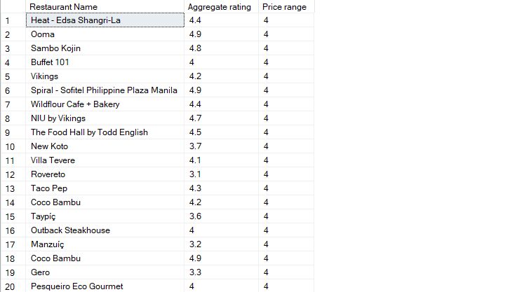
3.Display the aggregate rating and restaurant name where the price range above 3.5 ?
select [Restaurant Name],[Aggregate rating],[Price range] from [dbo].[zomoto1$] where [Price range]>3.5
OUTPUT:

Slide 6
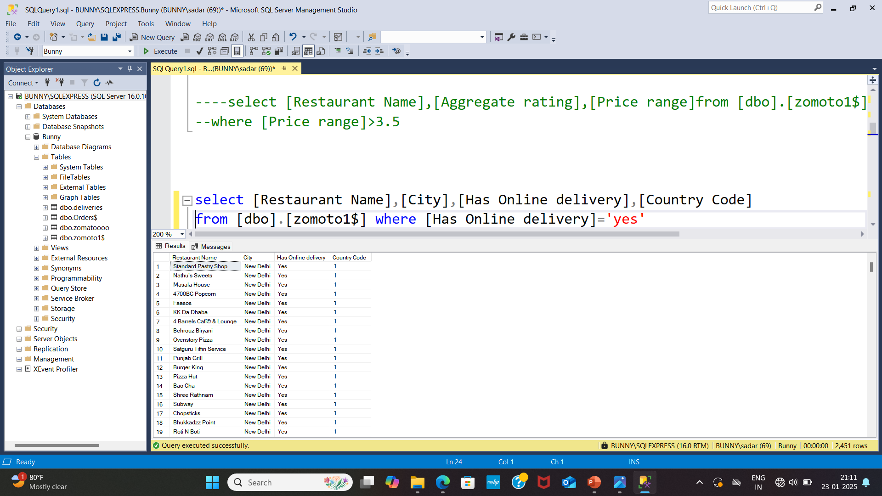
4.Find out the how many members are has order in online delivery along with country code and city name ?
Select [Restaurant Name],[City],[Has Online delivery],[Country Code] from [dbo].[zomoto1$] where [Has Online delivery]=‘yes’
OUTPUT:

Slide 7
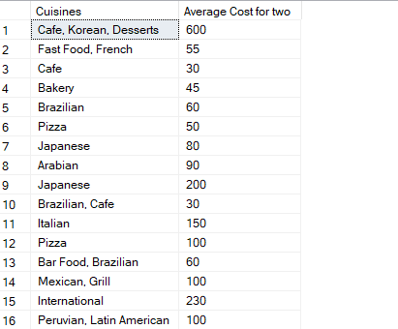
5.Find out the food items average cost for two below of 700 ?
select [Cuisines],[Average Cost for two] from [dbo].[zomoto1$] where [Average Cost for two]<700
OUTPUT:

Slide 8
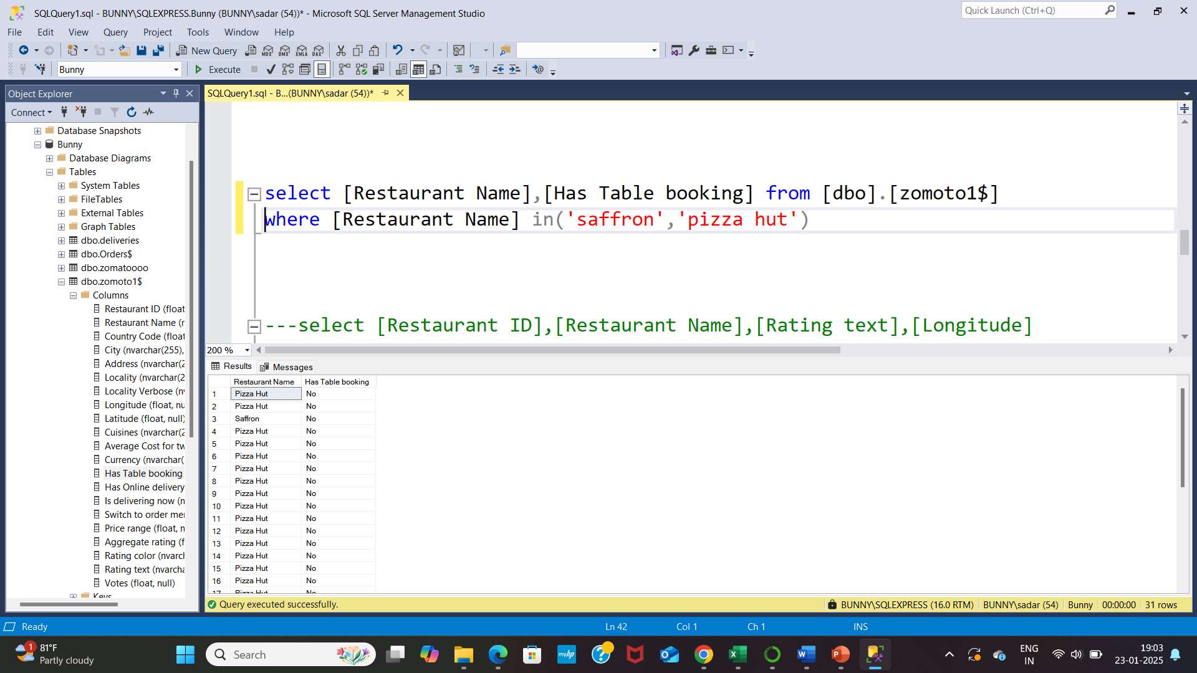
6.Find out the how many members has table customers where restaurant name is saffron and pizza hut ?
select [Restaurant Name],[Has Table booking] from [dbo].[zomoto1$] where [Restaurant Name] in(‘saffron’, ‘pizza hut’)
OUTPUT:

Slide 9
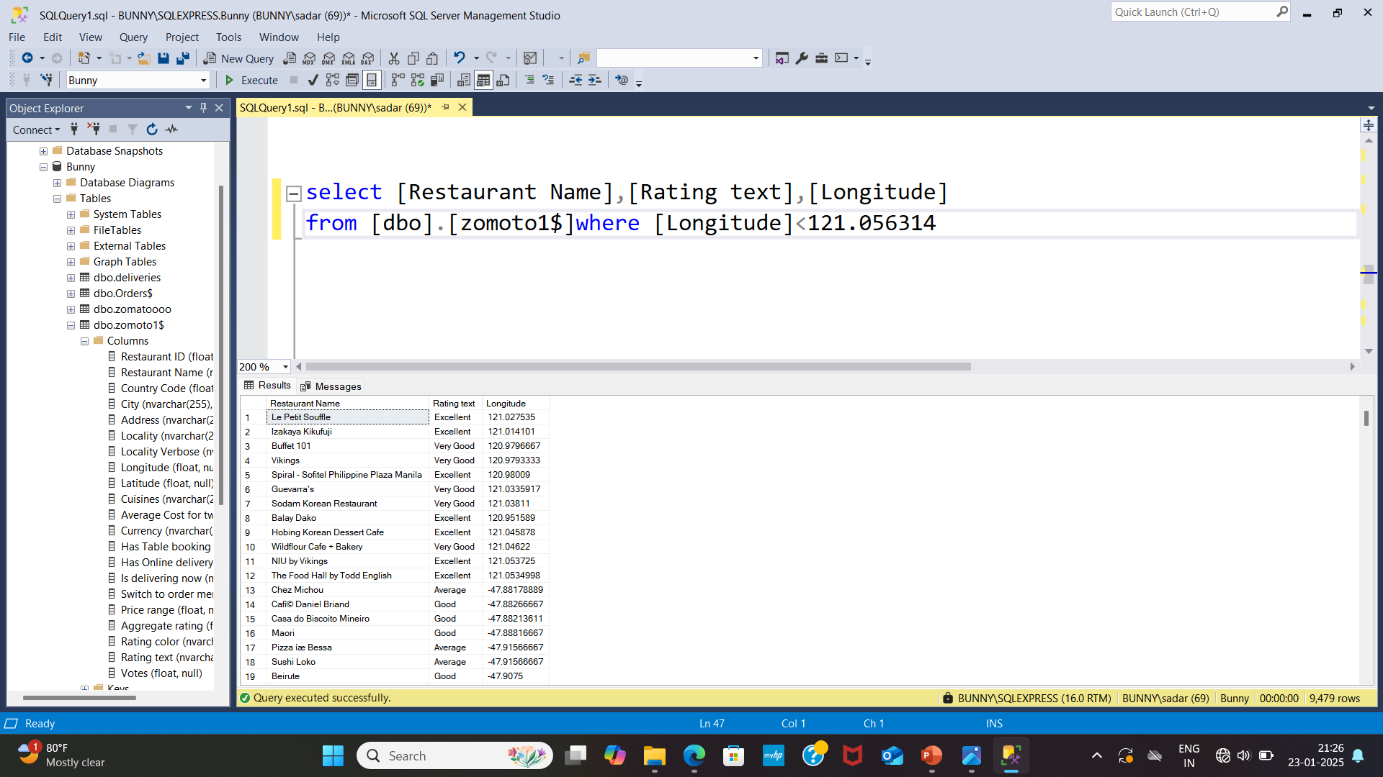
7.Display the longitude is below 121.056314 along with restaurant name and rating text ?
select [Restaurant Name],[Rating text],[Longitude] from [dbo].[zomoto1$]where [Longitude]<121.056314
OUTPUT:

Slide 10
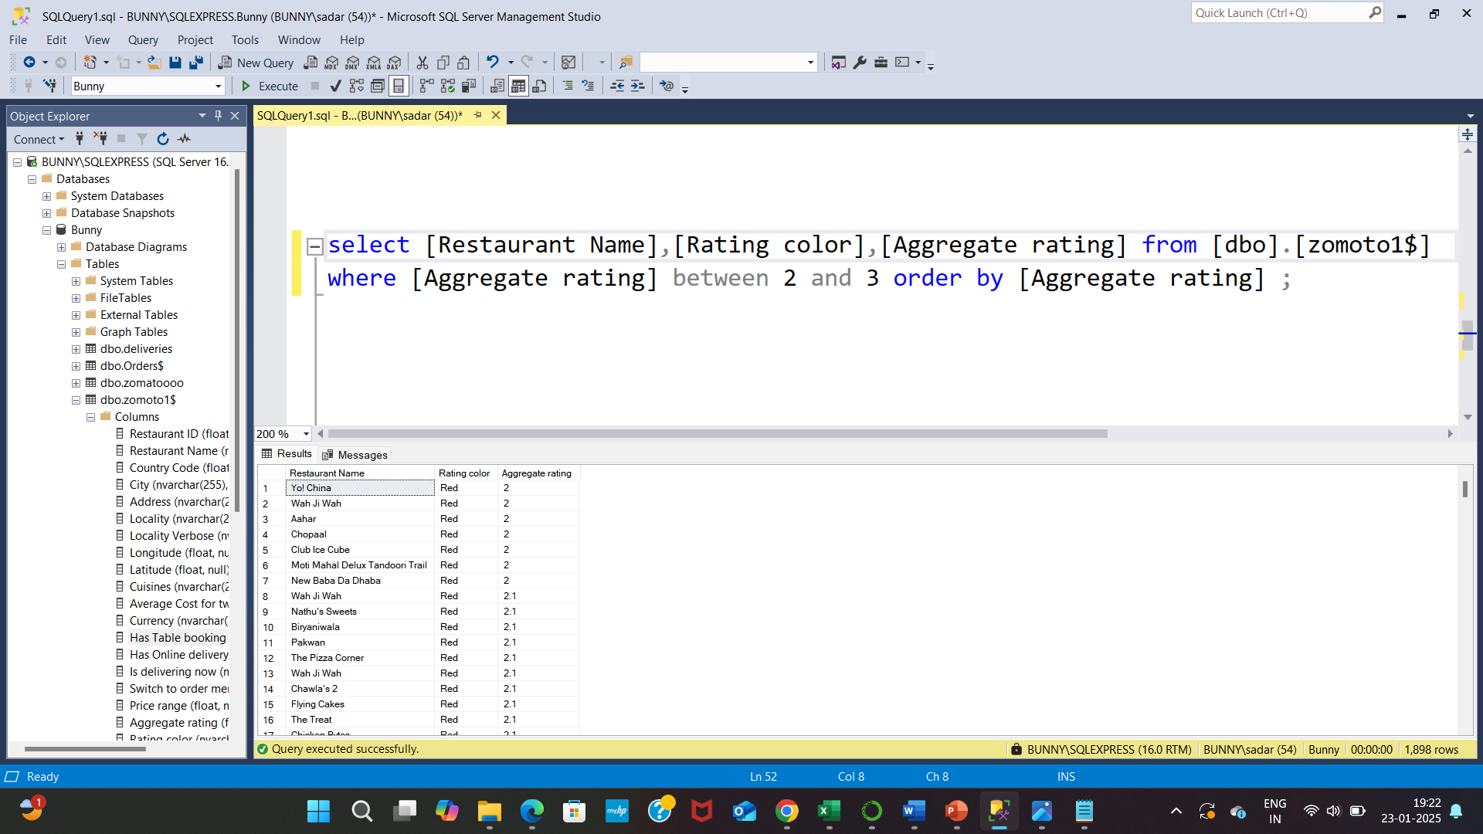
8.Display where the restaurant names and rating color where the aggregate rating between 2 and 3 ?
select [Restaurant Name],[Rating color],[Aggregate rating]
from [dbo].[zomoto1$] where [Aggregate rating] between 2 and 3
order by [Aggregate rating]
OUTPUT:

Slide 11
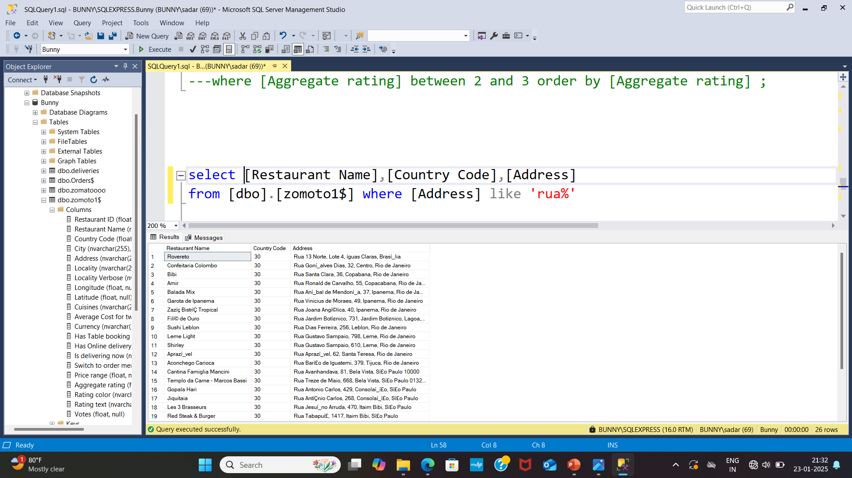
9.Display the restaurant name, country code where address start like Rua ?
select [Restaurant Name],[Country Code],[Address] from [dbo].[zomoto1$] where [Address] like ’rua%’
OUTPUT:

Slide 12
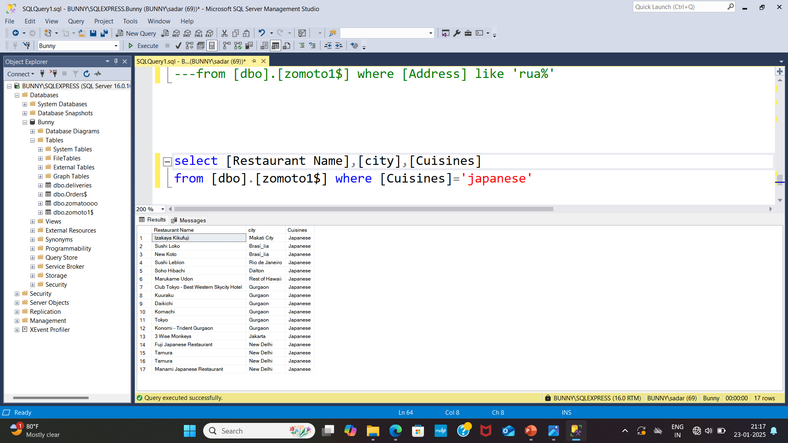
10.Display where the Japanese item available in restaurant ?
select [Restaurant Name],[city],[Cuisines] from [dbo].[zomoto1$] where [Cuisines]=‘japanese’
OUTPUT:

Slide 13


